Slide 1
Retrieving your latest Windchill license files

Slide 2
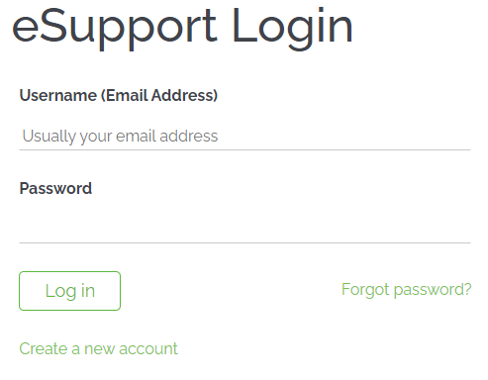
License retrieval
On the INNEO support page:
See the document on how to set up a PTC account if you do not have one
Open https://www.ptc.com/en/support website
Log in with your PTC account details.
(If you do have a PTC account but cannot access it, click on the link below to log a web account problem)
https://support.ptc.com/support/feedback/web-account.htm

Slide 3
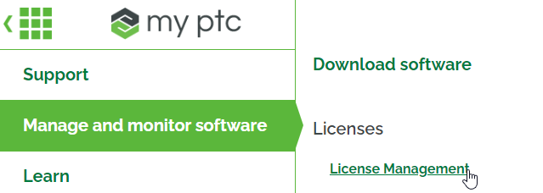
License retrieval
Click on the Menu icon in the top left corner to expand the option.
Click on Manage and monitor software
Click on License Management

Slide 4
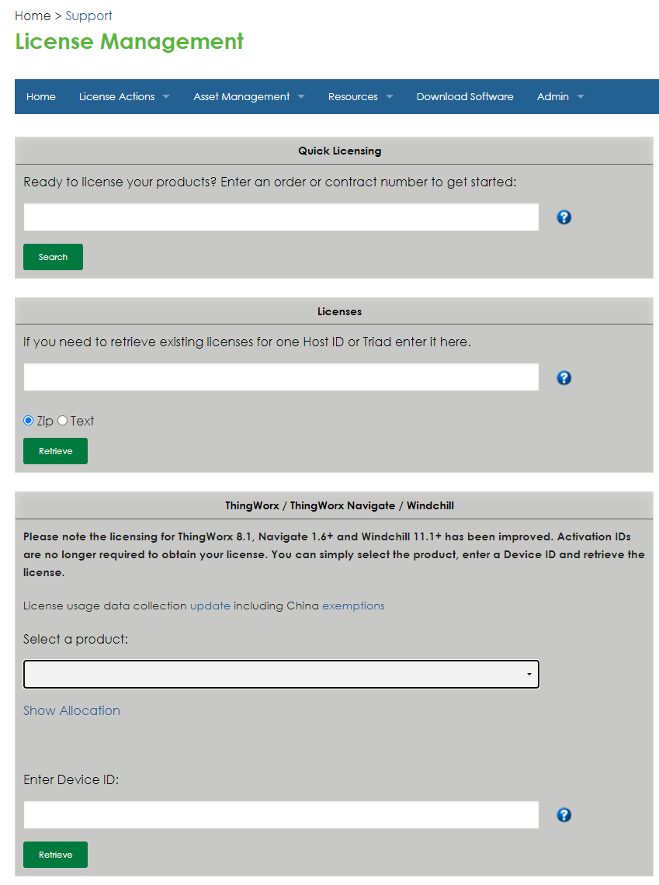
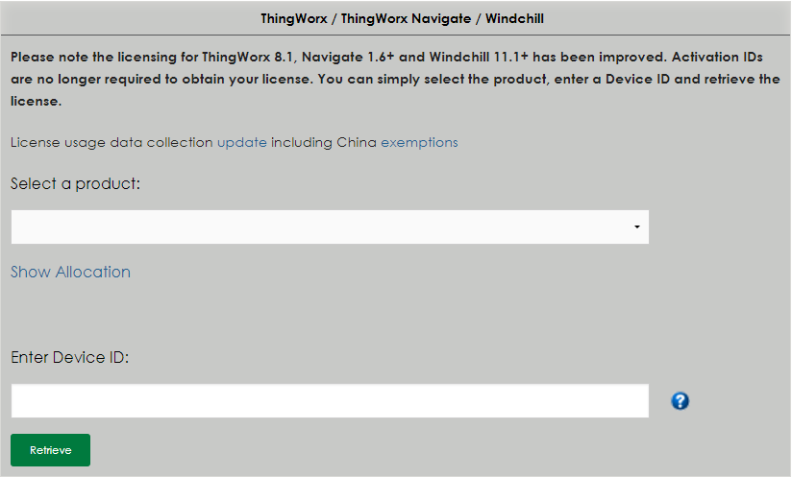
License retrieval
Select product Field: click pulldown arrow for selection of product type.
Enter device ID
If you do not know how to get the host ID: please see the next slide for information to get your License host ID
If any of the steps are not clear to you, please contact us at support@inneo.com
1
2

Slide 5
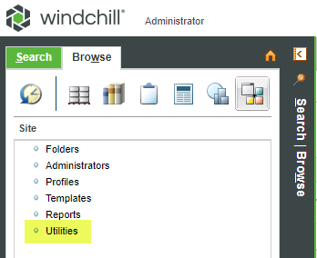
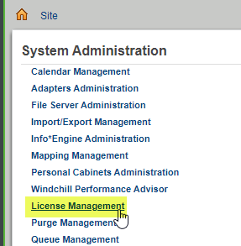
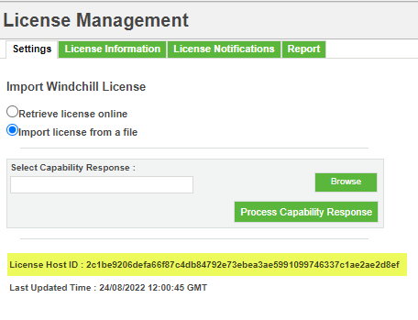
License retrieval
Steps to find the Windchill License host ID
Example: License Host ID : 2c1be9206defa66f87c4db84792e73ebea3ae5991099746337c1ae2ae2d8ef
Login into Windchill as “wcadmin”. Go to Site>Utilities>License management>Settings
Copy the License host ID

Slide 6
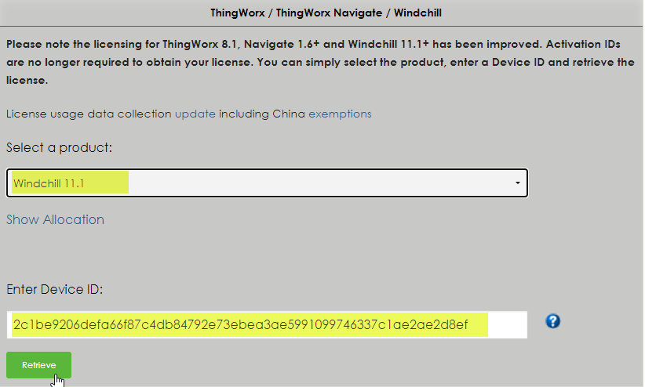
License retrieval
Go back to the PTC license portal. Ensure correct product is selected.
Now enter (paste) the Host ID
Select Retrieve
If any of the steps are not clear to you, please contact us at support@inneo.com
1
2
3

Slide 7
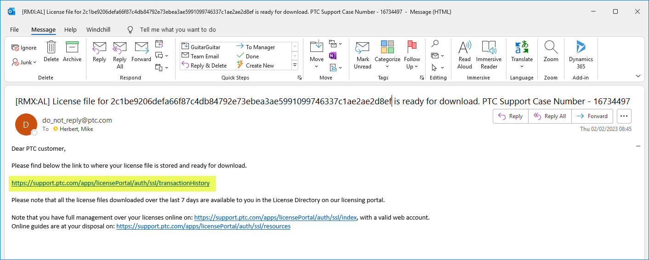
License retrieval
The PTC license portal will acknowledge your retrieve request with a message stating you will be emailed with a link inviting you to download your new license file.
Open the email and select the link (highlighted)

Slide 8
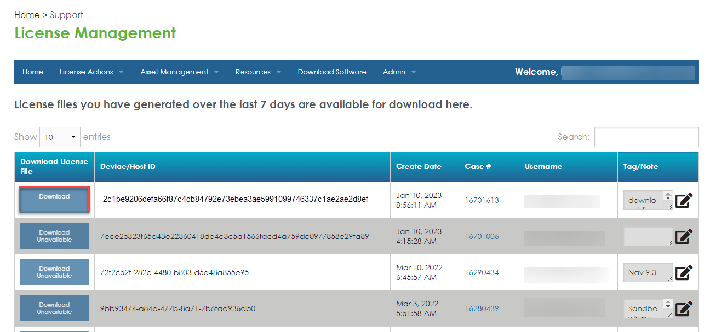
License retrieval
The link takes you to the license repository page.
Your new license pack will be at the top of the list ready to download.
After selecting the download button, you will be asked to add reason for download (Tag). Then the download will begin.
1
2

Slide 9
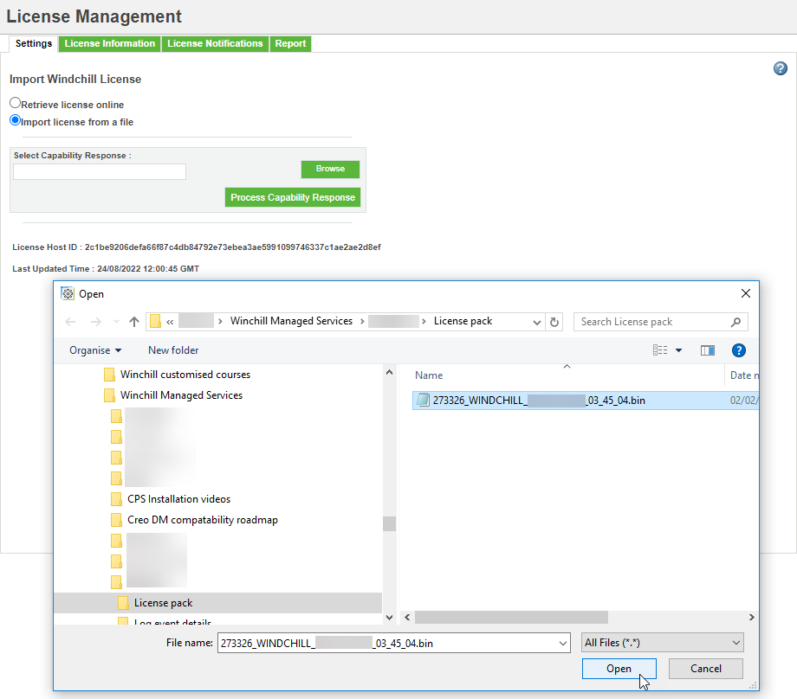
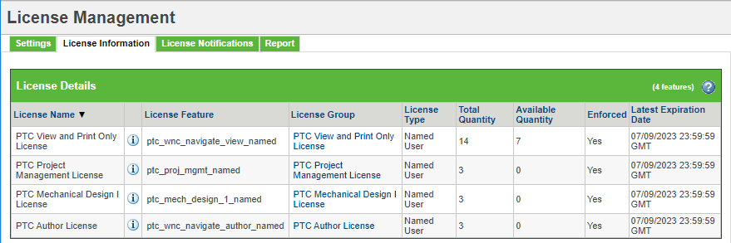
License retrieval
After the download go back to Windchill, Go to Site>Utilities>License management.
Select “Browse” and navigate to where the new license pack is stored. Select the file and “Open”.
This will load the file into the “Select Capability Response” field.
Now select “Process Capability Response” to process and load the new license pack.
Refer to the “license Information” tab to confirm new licenses have been loaded.
1
3
2
4
5

Slide 10
Thank you!
© INNEO Solutions Ltd | www.inneo.co.uk
Notes:
-> Paste: Customer or context of the presentation, name and date

